Slide 1

Lost And Found Portal
Theme- Sustainable Cities and Communities(SDG 11)
Category- SOFTWARE
Group No -1
Group Members -Vedant.M , Prathmesh.M , Manthan.P , Yatharth.P.
Guide- Dr.Rahul Ambekar.

Slide 2
Outline
Introduction
Literature Survey
Limitations of existing systems
Problem statement and Objectives
Proposed Methodology
Experimental Setup
Implementation
Results & Analysis
Conclusion and Future work
References

Slide 3
Introduction
Lost items are common in colleges.
No centralized digital tracking system.
Lack of transparency causes delays.
Students struggle to recover belongings.
Academic material resale is unorganized.
A digital system improves tracking and recovery,
making it faster and more organized.
Importance
Saves time and effort.
Reduces stress for students.
Improves institutional transparency.
Supports SDG 11 (Strong Institutions).

Slide 4
Current Challenges & Motivation
Current Challenges:
No tracking of claim status.
Important lost & found messages get ignored in busy WhatsApp groups.
No secure verification system.
No proper way to track previous posts
No platform for senior-to-junior exchange.
Motivation:
Observed inefficiency in campus process.
Frequent student complaints.
Need for digital accountability.
Desire to create structured campus ecosystem.

Slide 5
Objectives
Develop centralized web-based portal.
Allow users to report lost/found items.
Enable claim submission and admin approval.
Provide recovery percentage analytics.
Secure login system with authentication.
Add Senior2Junior academic resale module.
Ensure structured database design.
Improve transparency and efficiency.

Slide 6
Observation:
Survey of Existing Systems
Author & Year | Technique Used | Key Results | Limitations
Suchana et al., 2021 | Web-based system using HTML,CSS,PHP. | Simple interface , easy reporting of lost items. | No analytics , weak security.
Soumya et al., 2024 | Web + centralized campus platform. | Improved communication and fast recovery. | No claim verification , limited admin control .
Abhiram et al., 2024 (CampusTrace) | Web app with real-time updates. | Faster item tracking and notifications. | Depends on user input accuracy , no analytics.
Basic reporting features exist.
Lack of structured admin control.
No recovery analytics.
No academic resale integration.

Slide 7
Limitations of existing Systems
No centralized institutional deployment.
No claim approval workflow.
No statistical dashboard.
No recovery rate calculation.
Weak authentication systems.
No multi-role user system.
No resale system for academic materials.

Slide 8
Problem statement
College lacks structured digital system to:
Report lost items.
Track claims securely.
Monitor recovery statistics.
Maintain transparency.
Facilitate academic material exchange.
Goal:
To design a secure, scalable, and centralized web portal for campus-level
item management.

Slide 9
Main Module:
Proposed Methodology
System Architecture:
3-Tier Architecture: User Layer (Browser), Application Layer (Servlet/Tomcat),
Database Layer (MySQL).
Ensures secure, fast, and centralized data management.
Report Module – Submit lost and found item details
Search & Matching Module – Find matches using item name, category, and location
Claim & Notification Module – Allows users to claim items
Admin Module – Manage users and item records
User Authentication – Register/Login users securely

Slide 10
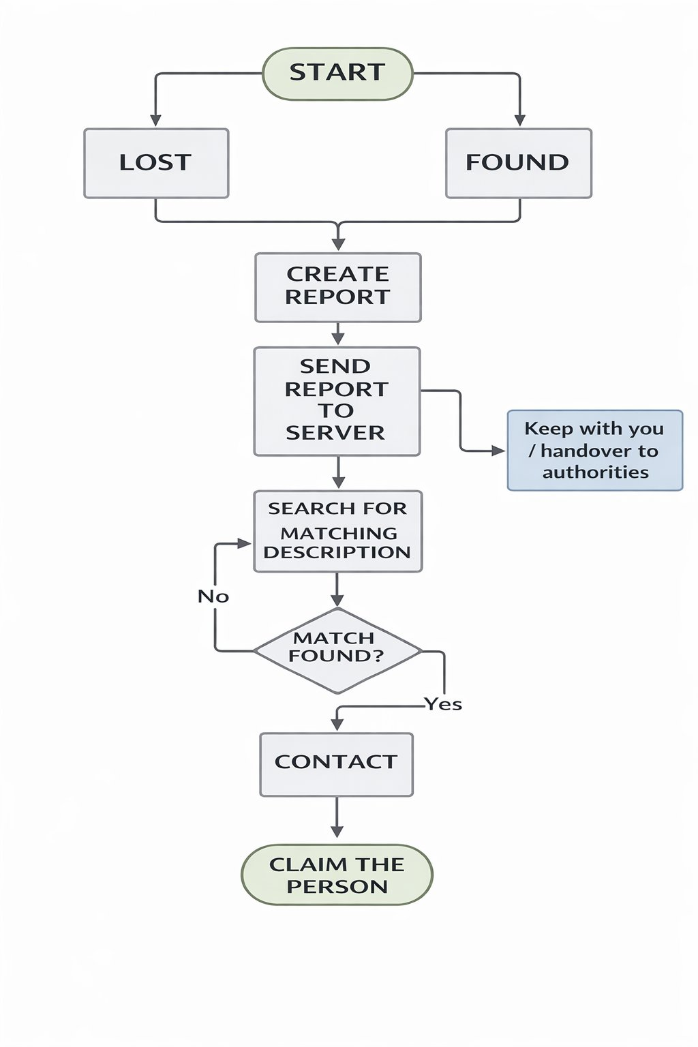
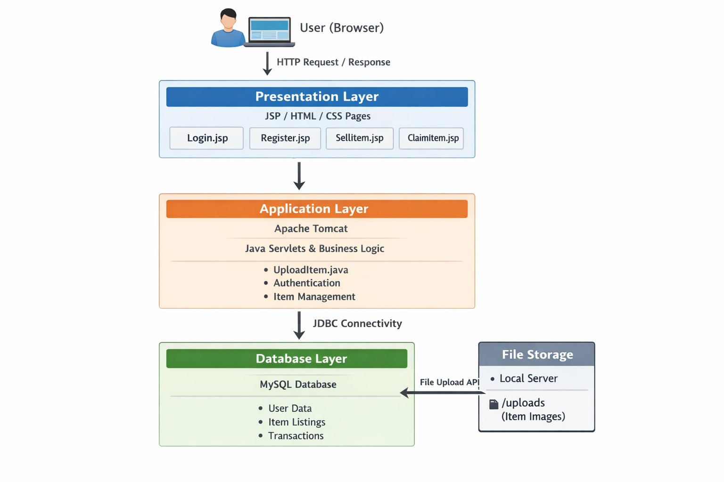
Architecture Diagram
Proposed System Architecture
Working Flow of System

Slide 11
Experimental Setup
Input / Dataset:
User-provided data including lost and found item details.
Item information: item name, description, category, location, date, and
user details.
Data stored and managed in MySQL database.
Performance Evaluation Parameters:
Successful user registration and login rate.
Accuracy of item storage and retrieval.
Response time for search and item reporting.
System reliability and database consistency
Technologies Used:
Frontend: HTML, CSS
Backend: Java JSP, Servlets
Database: MySQL
Server: Apache Tomcat

Slide 12
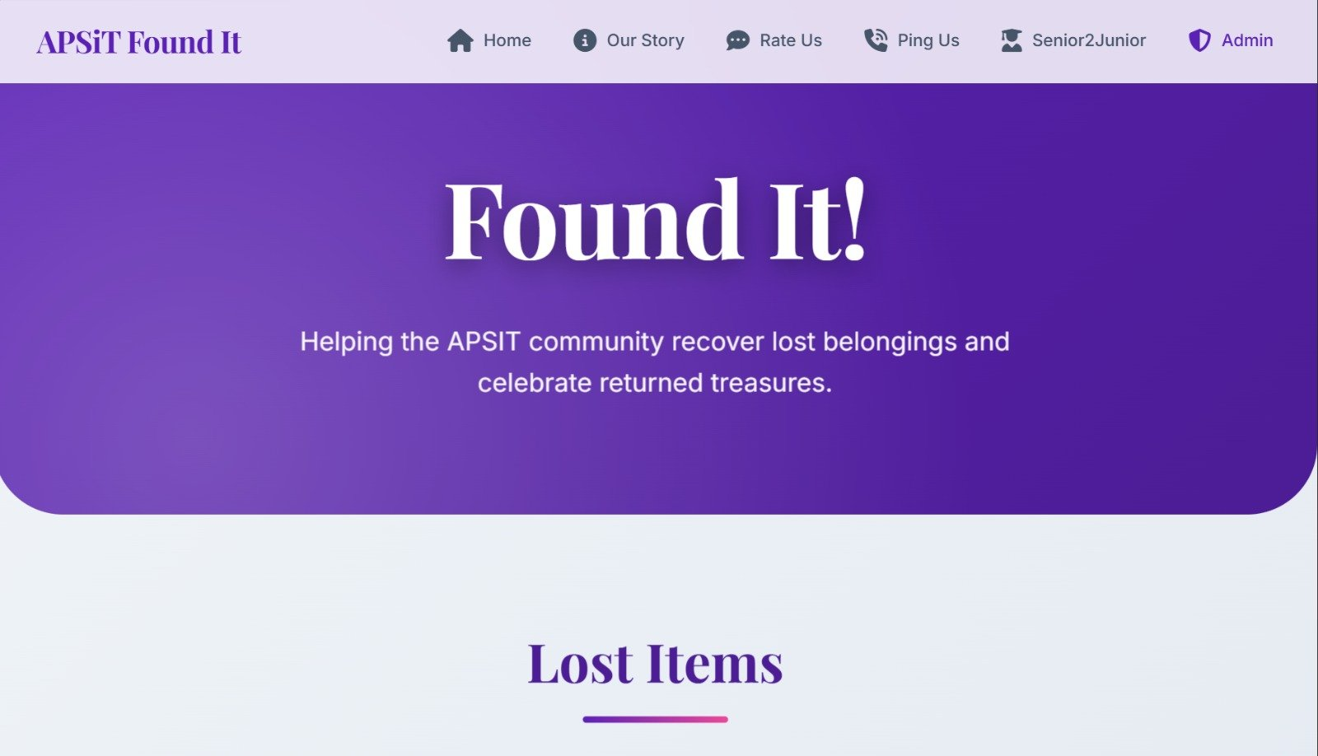
Implementation
Home Page

Slide 13
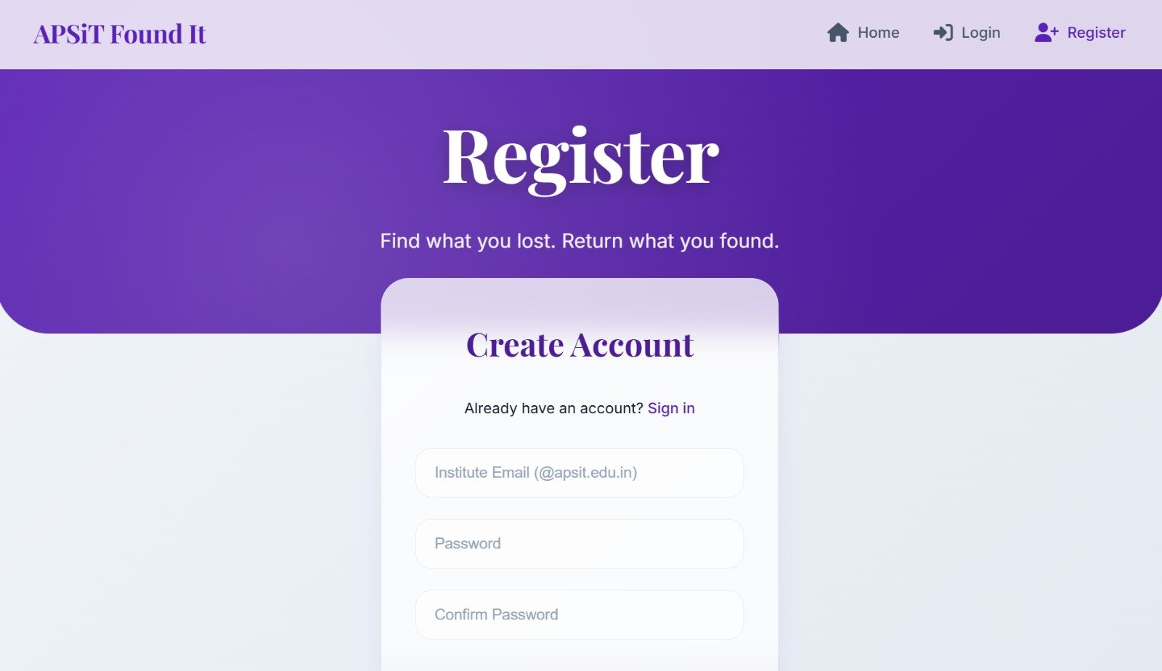
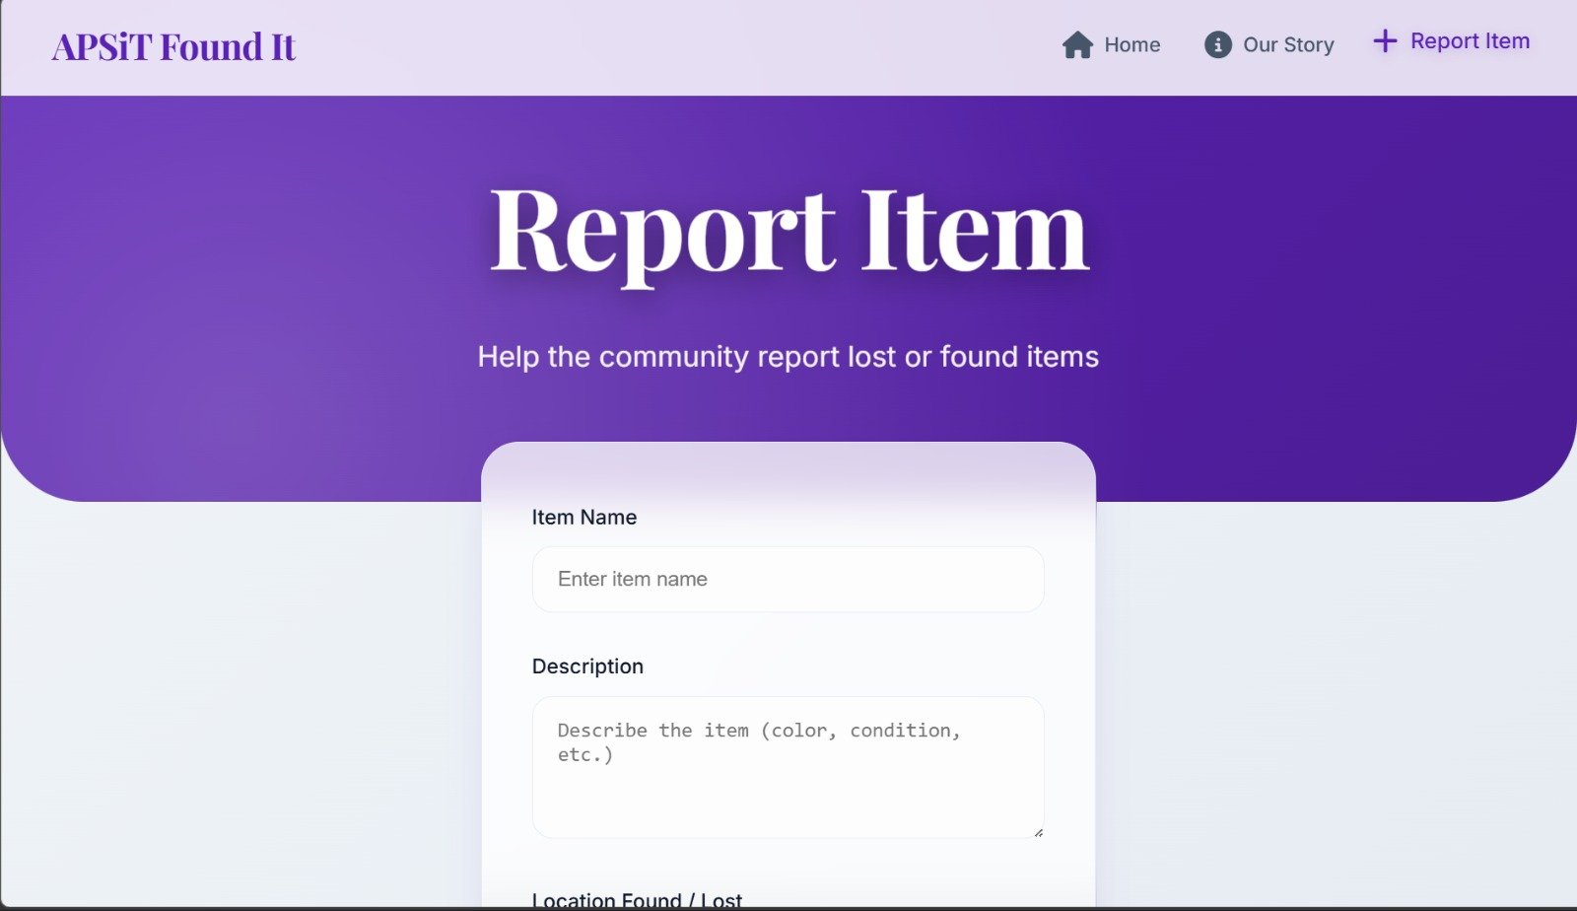
Implementation
Register
Report Item

Slide 14
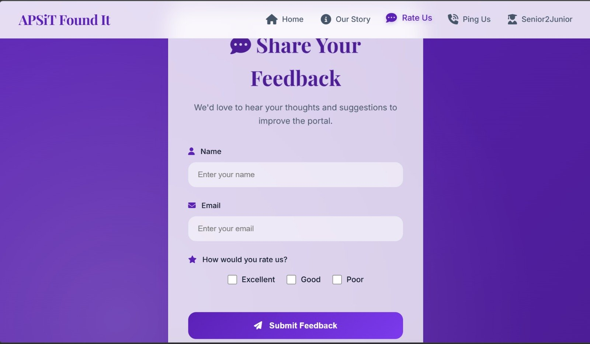
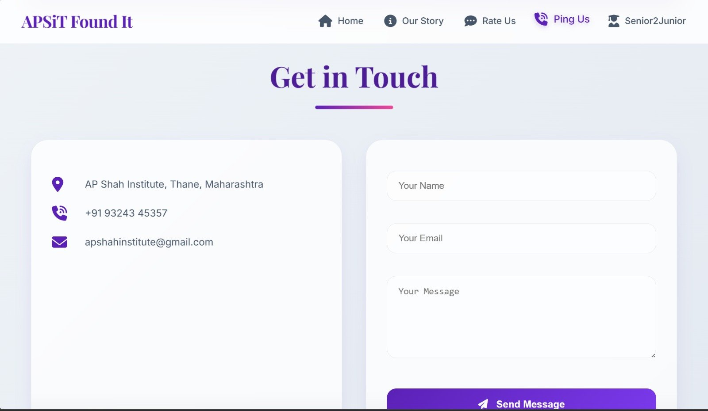
Implementation
Rate us
Ping us

Slide 15
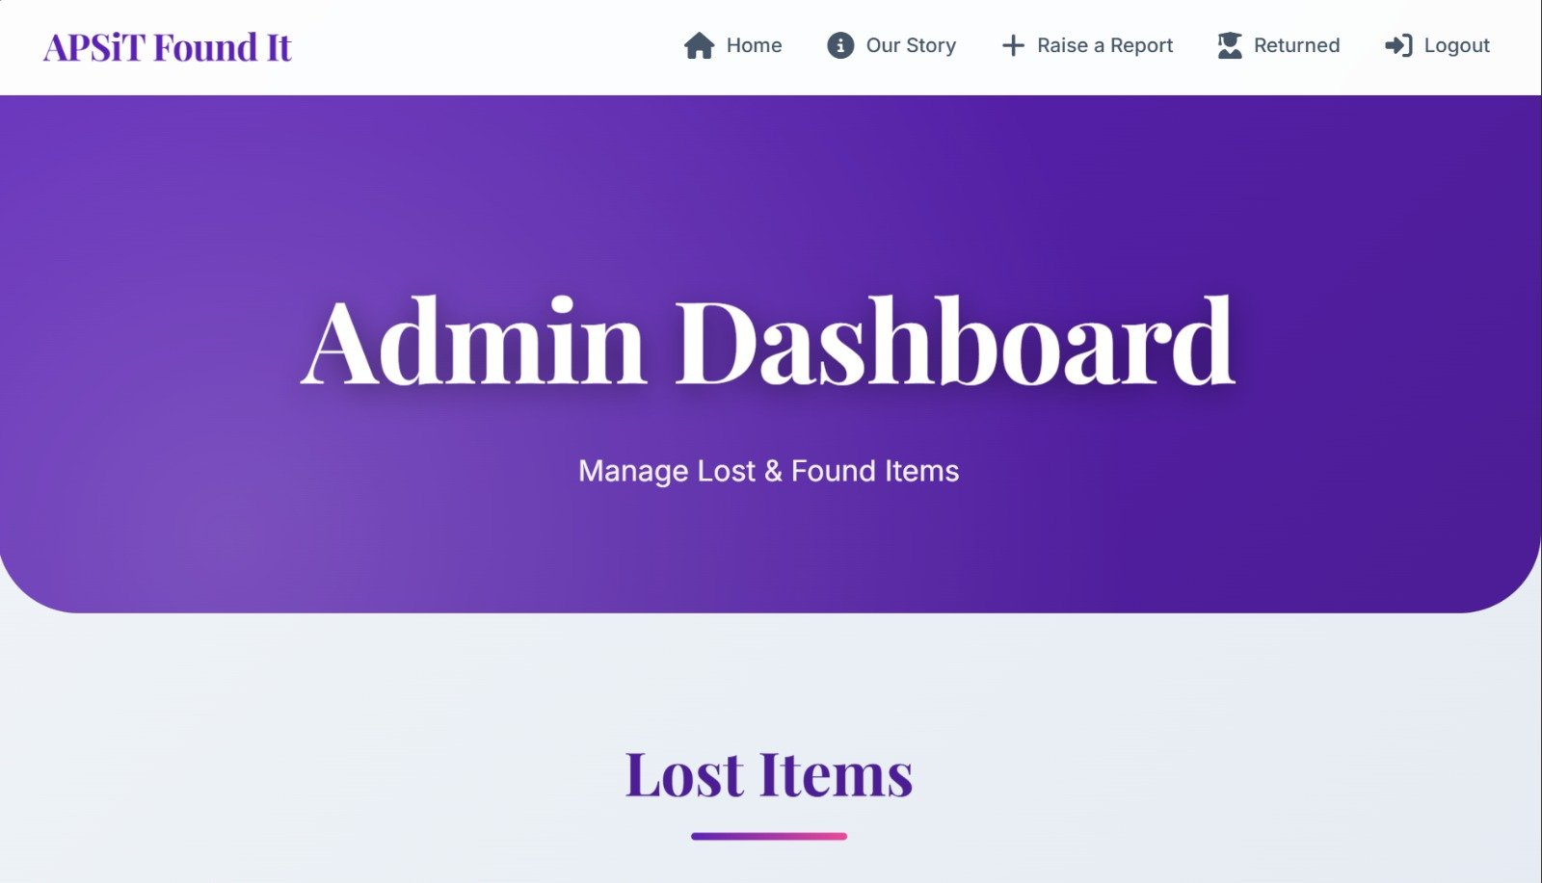
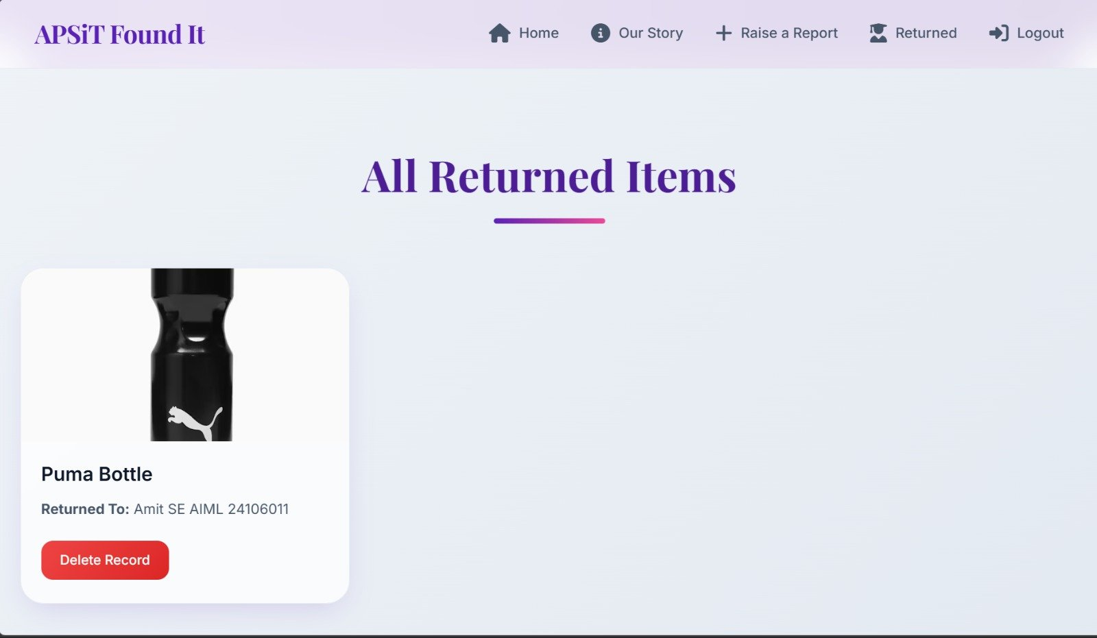
Implementation
Admin Dashboard

Slide 16
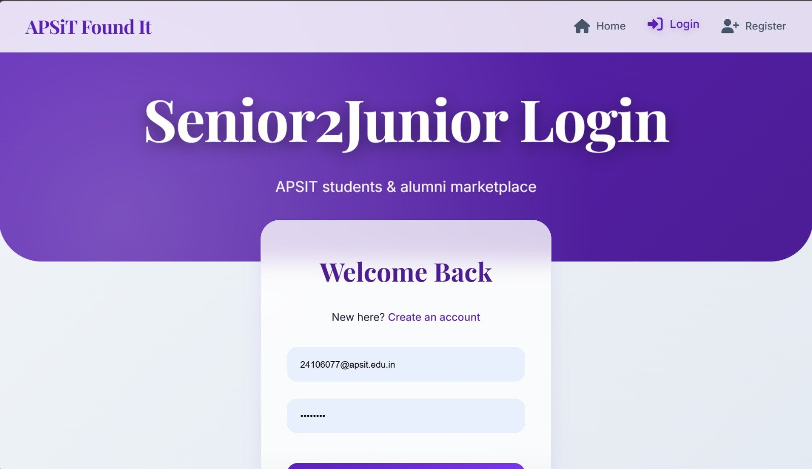
Implementation
Senior2Junior Page

Slide 17
Results & Analysis
System Performance Metrics:
Successful user registration and login functionality.
Accurate storage and retrieval of lost and found item records.
Fast response time for item search and reporting.
Reliable database operations without data loss.
FEATURE | EXISTING SYSTEM | PROPOSED SYSTEM
Item Tracking | Manual | Automated
Data Storage | Paper-based/scattered | Centralized MySQL database
User Access | Limited | Secure login system
Search Efficiency | Slow | Fast and efficient

Slide 18
Conclusion and Future work
Successfully developed a web-based Lost and Found Portal for efficient item management.
Centralized database system improves tracking, storage, and retrieval of lost and found items.
Achieved secure user registration, login, item reporting, and search functionalities.
Admin module enables proper monitoring and management of item records.
The system reduces manual effort and improves recovery efficiency.
Scope of Improvement :
Develop mobile application for better accessibility.
Add notification system for lost and found item matching.
Improve user interface and overall system performance.

Slide 19
References
[1] Suchana, K., Alam, S. M. E., Meem, A. T., et al. “Development of User-Friendly Web-Based Lost and Found System,” Journal of Software Engineering and Applications, 2021..
[2] Soumya, M., Mehak, S. Z., Chandra, V., et al. “Campus Lost: Connect and Recover,” International Journal of Engineering Technology and Management Sciences, 2024.
[3]
Abhiram, T., Krishnan, A., Manjith, K., et al. “CampusTrace: Application for Lost and Found Items on Campus,” Journal of Trends in Computer Science and Smart Technology, 2024.
[4] Wadbudhe , R., Ganesh, V., Patil, A., et al. “UniFind: Lost and Found Objects Management System using AI & Cloud,” International Journal of Latest Technology in Engineering Management & Applied Science, 2025.
[5]
Salha, Z., Pal, B. L. “Mewar Lost and Found Information System,” International Journal of Computer Science Engineering Techniques, 2025.

Slide 20
Thank Youuu....!!

